Slide 1
Workshop 1: Semester projects & R projects in R studio
BIOL90041
Week 2

Slide 2
Todays learning objectives
Quick review on %>% and is an R project and set up (15 min)
Practice data components of data cleaning in R using msleep data (40 min)
one table verbs and group summaries
using pipes
grouping, mutating, and filtering
Assign group projects (10 min)
Applying practice to your data (25min)
Quiz (30 min)

Slide 3


A basic R project set up
Getting organised : Root Folder
Your Project Name
.Rproj (R Project File)
Data
Script
Output
Notes:
One of the biggest hurdles for beginners in R is managing files—figuring out where your data is and why your script suddenly can’t find it.
This is where project organization makes a huge difference.
1st, it promotes reproducibility. If someone else—or future you—wants to rerun your analysis,
they can do so easily if everything’s structured properly.
2nd, it enhances portability. You can move your project across computers or share with collaborators without breaking paths or scripts.
3rd, it brings clarity to your workflow. Having a dedicated folder for data, scripts, and outputs helps you stay on track.
And finally, it’s just more efficient. You save time and avoid frustration by not constantly fixing file paths or wondering where that CSV went.
The figure here shows a clean directory structure using folders like Data, Scripts, and Outputs. This is what we’re aiming for

Slide 4
A basic R project set up
Getting organised : Data
Your Project Name
.Rproj (R Project File)
Reproducibility: Ensures analyses can be reliably repeated and verified.
Portability: Facilitates seamless collaboration and transition across different systems.
Clarity: Maintains a clean separation between raw data, scripts, and outputs.
Efficiency: Simplifies navigation and reduces errors in file handling.
Data
Script
Functions
Analysis A
Analysis B
Output
Tables
Plots
Notes:
One of the biggest hurdles for beginners in R is managing files—figuring out where your data is and why your script suddenly can’t find it.
This is where project organization makes a huge difference.
1st, it promotes reproducibility. If someone else—or future you—wants to rerun your analysis,
they can do so easily if everything’s structured properly.
2nd, it enhances portability. You can move your project across computers or share with collaborators without breaking paths or scripts.
3rd, it brings clarity to your workflow. Having a dedicated folder for data, scripts, and outputs helps you stay on track.
And finally, it’s just more efficient. You save time and avoid frustration by not constantly fixing file paths or wondering where that CSV went.
The figure here shows a clean directory structure using folders like Data, Scripts, and Outputs. This is what we’re aiming for

Slide 5
A basic R project set up
Now lets get organised : Data
Purpose: Store all raw datasets required for analysis.
Best Practices:
Keep original data unaltered to maintain integrity.
Use subfolders like Data/Raw/ for original data and Data/Processed/ for cleaned versions.
Example:
read.csv("Data/dataset.csv")
Notes:
Let’s start with the data folder. This is where all your input files go—CSV files, Excel sheets, or even RDS files.
You should separate raw data from processed data. Why? Because you want a clean record of your starting point.
In R, we’ll use relative paths like this: read.csv("Data/Raw/dataset.csv").
Notice that there’s no full path. This only works if we’re inside an RStudio Project—more on that soon.
Think of the data folder as the foundation of your analysis—don’t overwrite or edit files here manually.
Always write scripts to do any cleaning or transformations.

Slide 6
A basic R project set up
Now lets get organised : Script
Purpose: Contain all R scripts files for data processing and analysis.
Best Practices:
Organize scripts logically, e.g., Scripts/Data_Cleaning.R, Scripts/Analysis.R.
Use relative paths to reference data and outputs.
Example:
source("Scripts/Data_Cleaning.R")
Notes:
Next is the Scripts folder. This is where all your code lives: from data cleaning to statistical analysis to visualizations.
It's a good habit to name scripts clearly, like 01_data_cleaning.R, 02_analysis.R, and so on.
This helps you and your collaborators follow your logic.
When sourcing scripts or loading files, always use relative paths. For example: source("Scripts/01_data_cleaning.R")
And when you're working in an RStudio Project, R automatically knows to treat your project folder as the root directory.
This means you never need to hard-code full file paths—just stay consistent and organized.

Slide 7
A basic R project set up
Now lets get organised : Output
Purpose: Store results such as figures, tables, and reports generated from analyses.
Best Practices:
Separate outputs into folders like Outputs/Figures/, Outputs/Tables/
Ensure outputs are reproducible by generating them through scripts
Example:
ggsave("Outputs/Figures/plot.png")
Notes:
Outputs include everything you generate from your analysis—figures, tables, and maybe even model summaries.
A good practice is to separate these into subfolders, like Outputs/Figures/ or Outputs/Reports/.
That way, when you're writing papers or giving talks, everything you need is easy to find.
Here’s an example: ggsave("Outputs/Figures/plot.png")
You should always generate outputs through scripts,
so they can be reproduced by anyone running the code.
Never copy/paste files manually into this folder.

Slide 8
A basic R project set up
Now lets get organised : Project
Purpose: Define the root of the project, enabling consistent relative paths.
Benefits:
Automatically sets the working directory to the project root.
Enhances collaboration by avoiding hard-coded paths.
Notes:
Now for the glue that holds it all together—the RStudio Project file, or .Rproj.
This tiny file sets the working directory to your project root automatically.
That means when you write read.csv("Data/Raw/dataset.csv"),
it’ll work no matter where your project is located,
because it’s relative to the .Rproj file.
This makes your code portable and removes the guesswork about where R is looking for files.
When you open the .Rproj, RStudio knows where to start. This is crucial for collaboration and for preventing those dreaded ‘file not found’ errors.
Bottom line: Always start your projects with File > New Project in RStudio.
Then use that .Rproj file every time.”

Slide 9

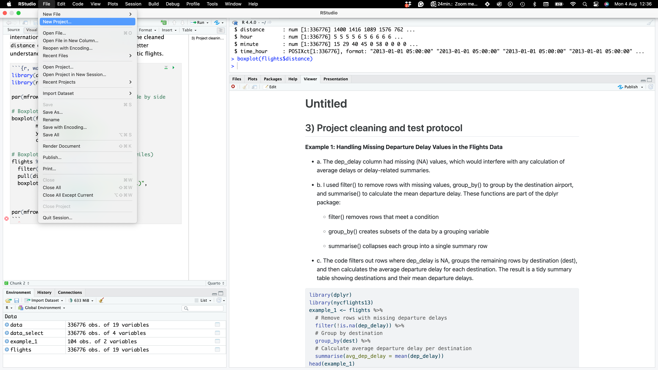
Stop and Code (3 mins)
A basic R project set up
Data_Science_for_Biologists
Data_Science_for_Biologists.Rproj
Create a project ON YOUR DESKTOP using the following structure
Add in your lecture script
Add in your group project data
Data
Project_data
data1.csv
data2.csv
Lecture_script.R
Output
Plots
Powerpoints

Slide 10
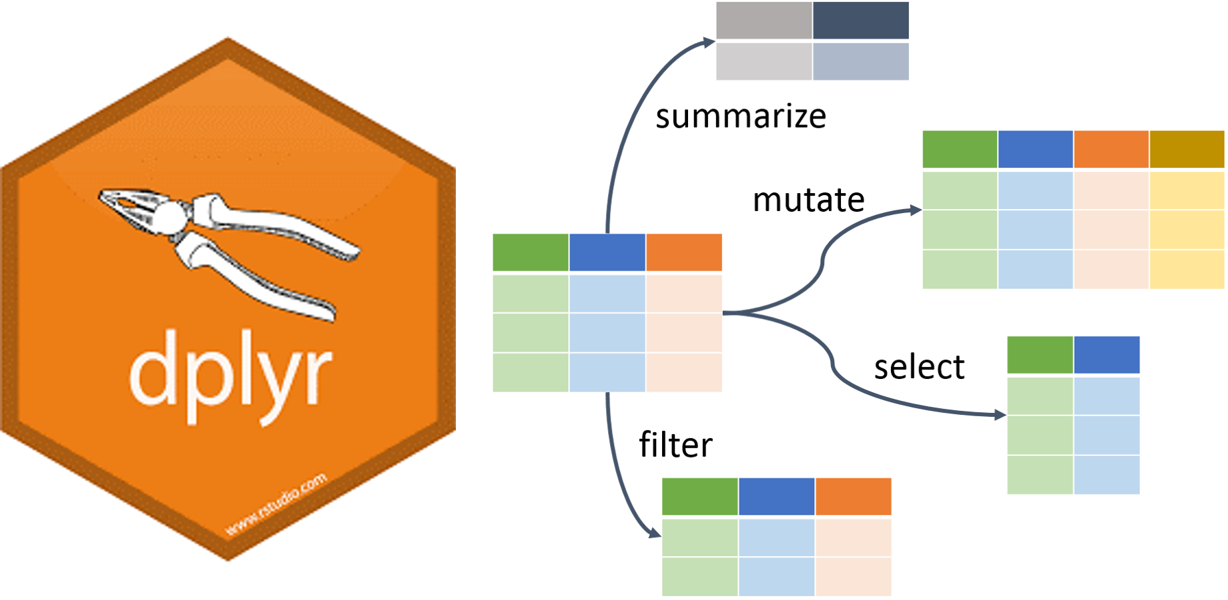
Data manipulation practice with dplyr

Slide 11


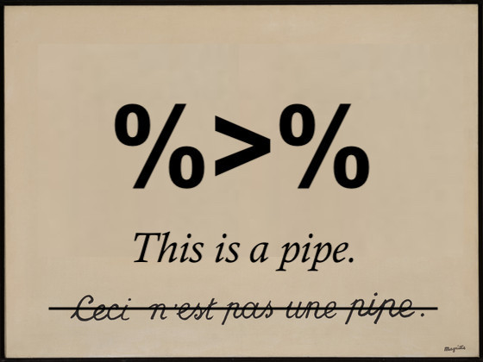
Stringing together multiple dplyr commands… THE POWER OF PIPES
All of these functions work fine on their own. But if we want to string together multiple dplyr commands and result in one tibble, we have to save our objects at each step of the way.
# create a flights tibble that displays only average departure and arrival delays for # days on which either of those averages are greater than 30 minutes:
A1 = group_by(flights, year, month, day)
A2 = select(A1, arr_delay, dep_delay)
A3 = summarise(A2, arr = mean(arr_delay, na.rm = T),
dep = mean(dep_delay, na.rm =T))
A4 = filter(A3, arr > 30 | dep > 30)
Notes:
But doing things like we did on the previous slide can be tedious and make lines and lines of code.
This is were dplyr is king… We can string things together..
CLICK.
SO say we have all if this code.
Can someone tell me what A1 is doing
A2
A3
A4?
Rather than doing all of that this is where the pipe comes in!
CLICK

Slide 12
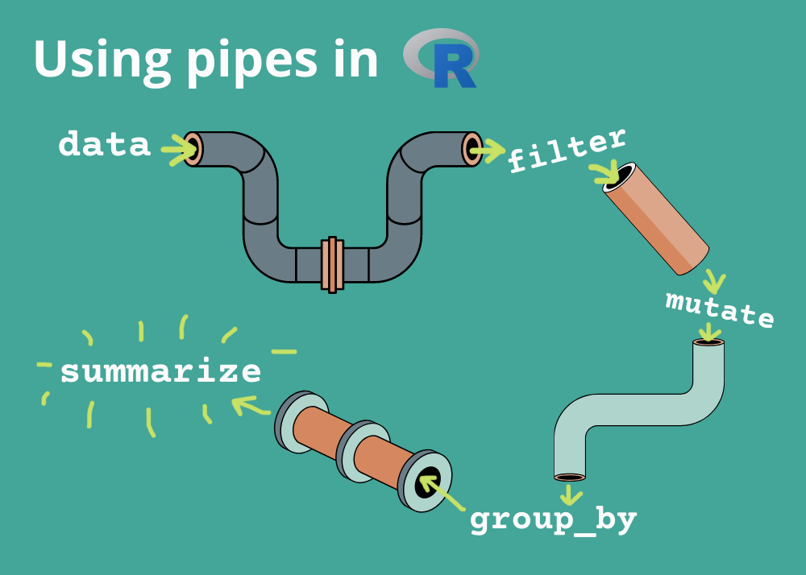
Stringing together multiple dplyr commands… THE POWER OF PIPES
What’s a pipe? A forward‐pipe operator that passes the output of one expression as the first argument to the next.
Why use pipes?
Makes code linear and readable
Eliminates nested function calls
Encourages stepwise data transformation
Key package: %>% comes from magrittr (and is re‐exported by dplyr, tidyverse, etc.)
Notes:
Pipes let us chain together multiple dplyr commands in a clean, readable way.
The pipe operator %>% takes the result of one line of code and passes it as the first argument to the next function.
S
o instead of nesting functions inside each other — which can get confusing — we write code step by step, in the order it’s applied.
This makes our workflow more transparent and easier to debug.
The pipe comes from the magrittr package but is also available when we load dplyr or tidyverse.
We’ll use pipes throughout the rest of the course, so it’s good to get comfortable with them now.

Slide 13
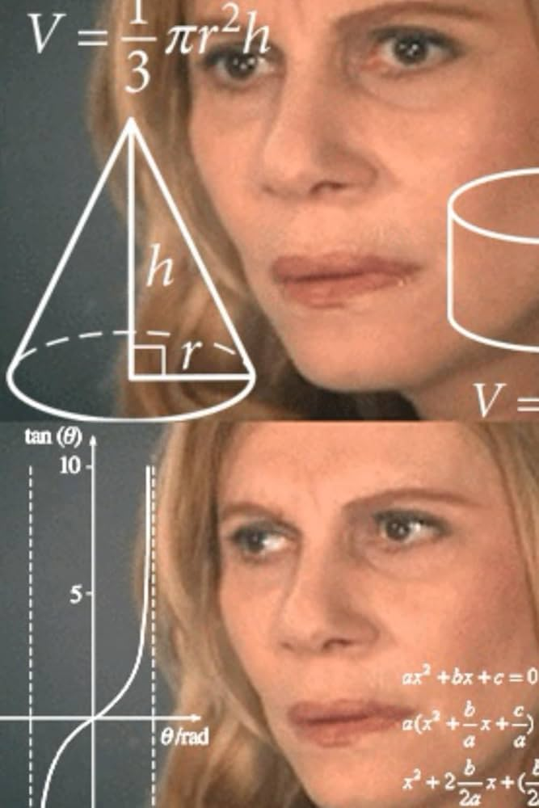
Stringing together multiple dplyr commands… THE POWER OF PIPES
All of these functions work fine on their own. But if we want to string together multiple dplyr commands and result in one tibble, we have to save our objects at each step of the way.
# create a flights tibble that displays only average departure and arrival delays for # days on which either of those averages are greater than 30 minutes:
A1 = group_by(flights, year, month, day)
A2 = select(A1, arr_delay, dep_delay)
A3 = summarise(A2, arr = mean(arr_delay, na.rm = T),
dep = mean(dep_delay, na.rm =T))
A4 = filter(A3, arr > 30 | dep > 30)
This will clutter up your environment

Slide 14
Stringing together multiple dplyr commands
Alternatively, we can write each command within the subsequent command:
# E.g., from the previous slide:
flights %>%
group_by(year, month, day) %>%
select(arr_delay, dep_delay) %>%
summarise(
arr = mean(arr_delay, na.rm = TRUE),
dep = mean(dep_delay, na.rm = TRUE),
.groups = "drop") %>%
filter(arr > 30 | dep > 30)
flights data frame
↓ group_by()
↓ select()
↓ summarise()
↓ filter()
Notes:
Here’s what it looks like when we string together multiple dplyr commands using pipes.
We start with the flights dataset and then: → group the data by year, month, and day, → select just the arrival and departure delays, → summarise those columns to get the mean delay, → and finally filter to show only days where delays were large.
The syntax flows top to bottom — each step builds on the last. This is much more readable than nesting functions and lets us clearly follow the logic of our data transformation.
The .groups = "drop" argument is used here to remove the grouping once we’re done summarising.

Slide 15

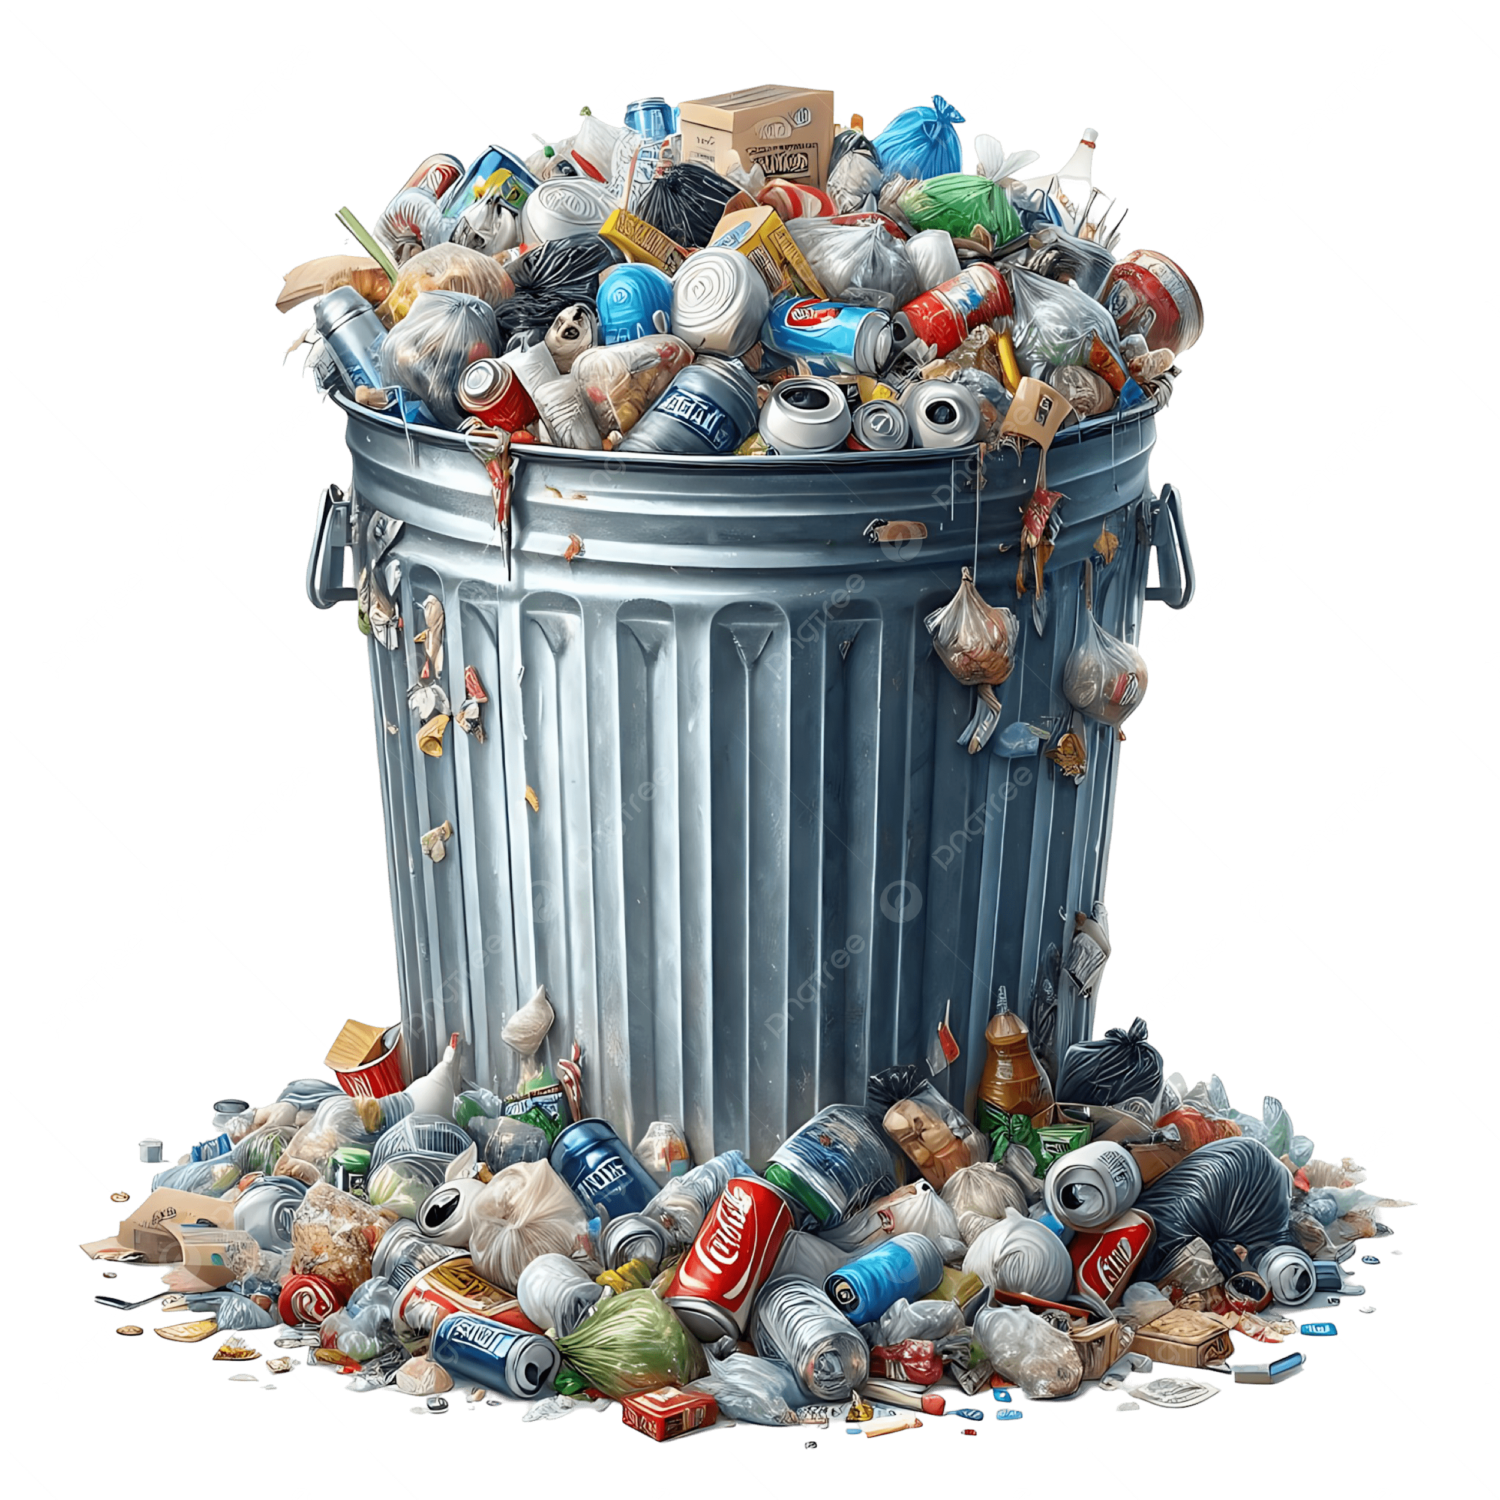

Using AI
Think of AI as…
A “calculator for words” – it predicts the next token based on context, so more detail = better result.
A paired programmer – don’t expect perfection up front; break problems into steps, discuss your approach, then iterate.
Iterate & Refine
Share your errors or unexpected outputs
Explain “this is what I got vs. what I expected” to help the AI self-correct
At the end of the day if you don’t know the ‘R language’… Don’t expect AI to solve your problems

Slide 16
Today’s learning objectives
msleep data
One table verbs & grouped summaries
Data pipelines
Grouped mutate/ﬁlter & window functions
Apply to your group data

Slide 17

The bad news: It’s going to be frustrating
© Allie Brosh

Slide 18
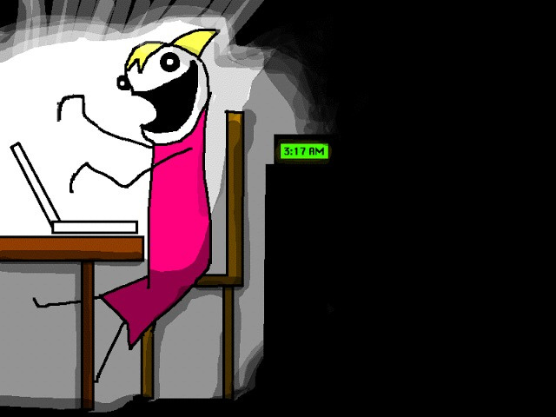
The good news: Frustration is typical and temporary
© Allie Brosh

Slide 19
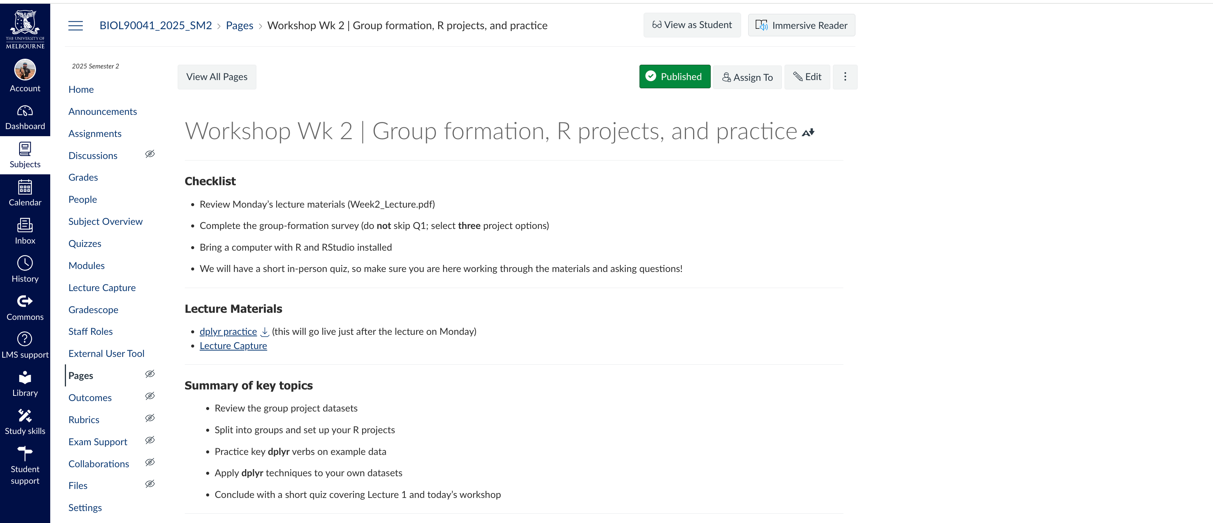
Download this!

Slide 20
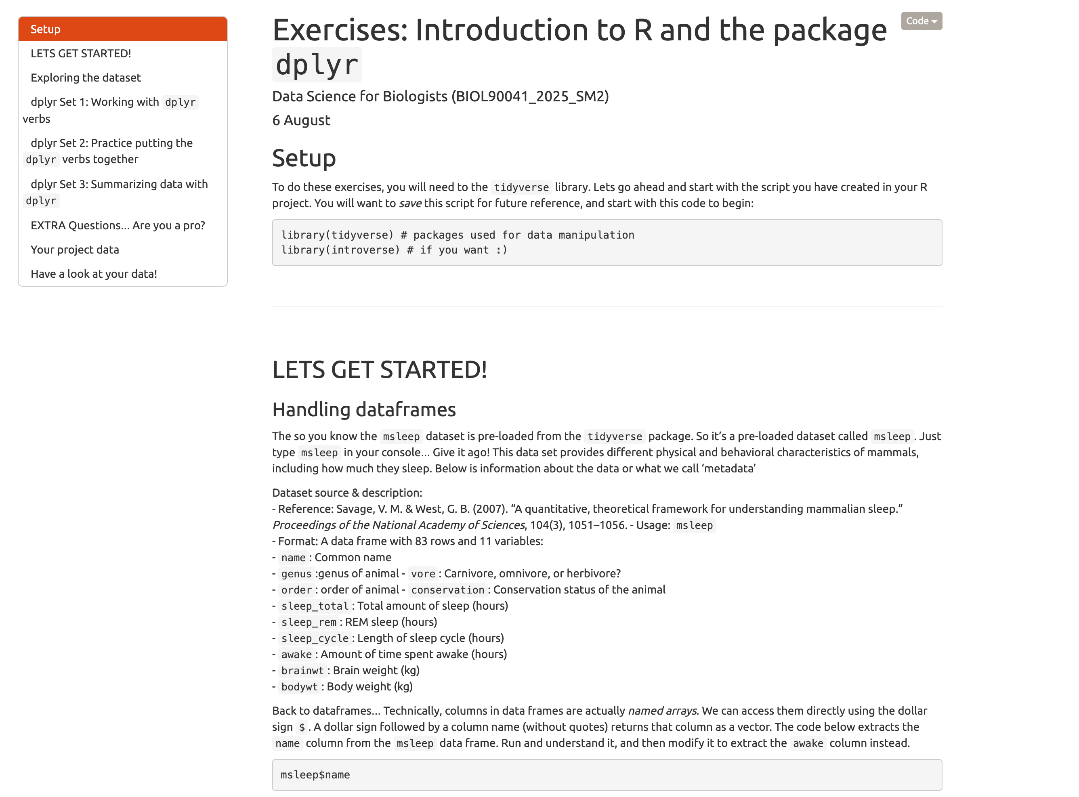
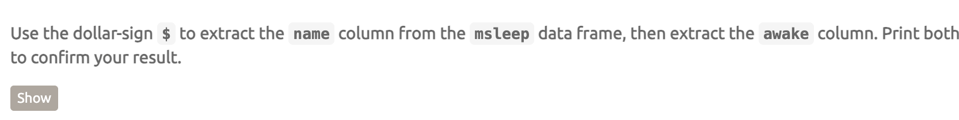
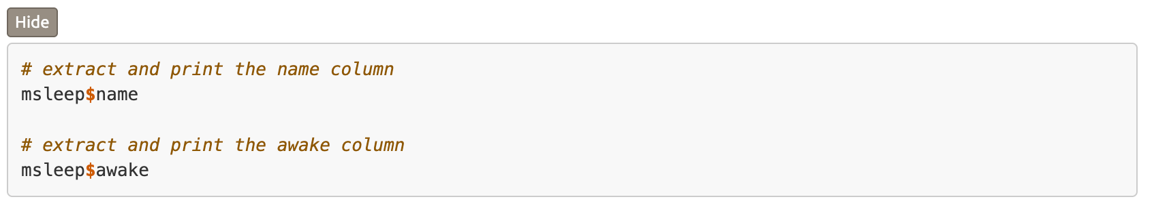
1. Topics you will
be covering
2. Your practice
3. Answer

Slide 22
Group project through the semester

Slide 23
Semester group projects
15%
30%
POSTER IN GROUPS
REPORT (INDIVIDUAL)
GROUP PROJECT

Slide 24
Group projects
To keep in mind
Completion of the project is expected to happen mostly during the workshops. You will sit with your group and talk about what needs to be done. Everyone should keep a record of what is happening with the data.
There will be an evaluation (by group members) on contribution/participation. Essentially, do all group members deserve 100% of the mark the group gets?

Slide 25
Group projects
To keep in mind
Clean data with data ready for plots and analyses.
- Creation of new variables, creation of new dataframes required.
Workshop 1 (today)
Workshop 2
Workshop 3
Data cleaning
Data exploration

Slide 26
Group projects
To keep in mind
Examples: Is your variable of interest already present in the dataset? Or does it need to be calculated or adjusted?
Do you have a case of repeated measures or do you need to summarise or filter data to be able to answer one of the questions?
Clean data with data ready for plots and analyses.
- Creation of new variables, creation of new dataframes required.
Workshop 1 (today)
Workshop 2
Workshop 3
Data cleaning
Data exploration

Slide 27
Group projects
To keep in mind
Coding assignment 1 (20%)
Workshop 1 (today)
Workshop 2
Workshop 3
Data cleaning
Data exploration
This process needs to be documented
The assignment is individual so does not have to be the same (and should not be the same)

Slide 28
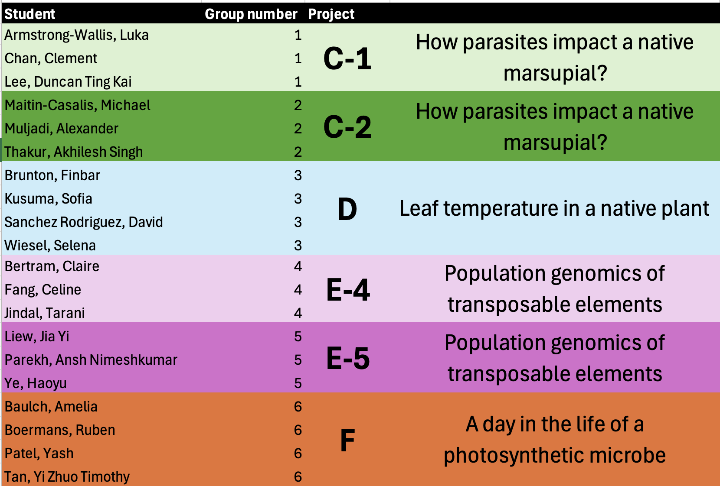
Group assignment
Kris (1-3)
Rory (4-6)

